Slide 1
2026 GP Election Judge Training
Presented by:
Jessy Harvey
The Illinois State Board of Elections

Slide 2



Housekeeping
Sign In
Questions
Cell Phones

Slide 3
Important Dates Prior to Election Day
Early Voting: | February 5, 2026 – March 16, 2026
Vote by Mail: | February 5, 2026 – March 12, 2026
Close of Registration: | Regular: February 17, 2026 Online: March 1, 2026
Grace Period Registration & Voting: | March 2, 2026 – Election Day: March 17, 2026

Slide 4

Overview
The Basics
Role of Election Judges Pollwatchers Campaign Free Zone Write-Ins
During Voting Hours
Judges Stations Assisting Voters Spoiled Ballots Provisional Voting
Before the Polls Open
Equipment Setup Polling Place Setup Supplies and Forms
After the Polls Close
Counting Write-In Votes Forms to Complete Materials to Return

Slide 5
Thank You!!
Election Judges play a vital role in the election process and are to be commended for helping to ensure the integrity of elections in Illinois. Training of election judges is crucial to the success of the election process. We thank all election judges for serving.

Slide 6

Your Role as Election Judges
Uphold the U.S. and Illinois Constitutions
You Serve as Officers of the Circuit Court
Sole Authority in the Polling Place
Sole Authority in the Campaign Free Zone
Ultimately You are Responsible for the Proper Conduct of the Election

Slide 7
Things to Remember…
Rotate Positions | It reduces fraud and its law
Act as a Board | You serve as a board - majority rules, whenever there is a decision to make, a majority of election judges will make the decisions.
Have Equal Authority | You all have equal authority in the polling place on Election Day! There is no “Head Judge”

Slide 8

Who else may be present in the polls on Election Day
Law Enforcement Officials
Representatives of:
- Attorney General
- State’s Attorney
- Election Authority
- State Board of Elections
Qualified Pollwatchers
(with proper credentials)

Slide 9
Pollwatchers: Who are they?
Registered Voter in Illinois
Must Have Credentials Issued by Election Authority or State Board of Elections
Appointed by:
- Candidates
- Political Parties
- Civic Organizations
- Proponents or Opponents to a Proposition
Candidates CAN be Pollwatchers

Slide 10
Pollwatchers: How do we know?
Pollwatchers must have credentials to visit your precinct.
Must SURRENDER credentials to you
You KEEP their credentials and place them in the appropriate folder or envelope
Sign in and out when they come and go
Return credentials to the Election Authority

Slide 11
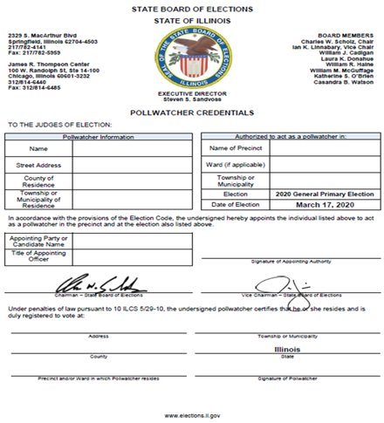
Pollwatchers Credentials

Slide 12
Pollwatcher Rights
May OBSERVE all proceedings and reasonably requested records pertaining to the conduct of the election
LOOK but don’t touch – pollwatchers cannot touch or handle any of the materials
May come and go throughout the day
May call attention to incorrect procedure
May challenge the qualifications of a voter

Slide 13


Campaign Free Zone
100 HORIZONTAL FEET FROM THE ENTRANCE TO THE POLLING PLACE/ROOM
No Campaign Signs
No Electioneering of Any Kind
No Campaign Buttons, Hats, or Shirts
YOU ARE THE SOLE AUTHORITY OF THE CAMPAIGN FREE ZONE!

Slide 14
Before The Polls Open

Slide 15

Getting Started
Arrive at your designated time
If judge do not show up – CALL!
Check supplies – is anything missing? CALL!
CALL! your Election Authority if you run into ANY issues!

Slide 16
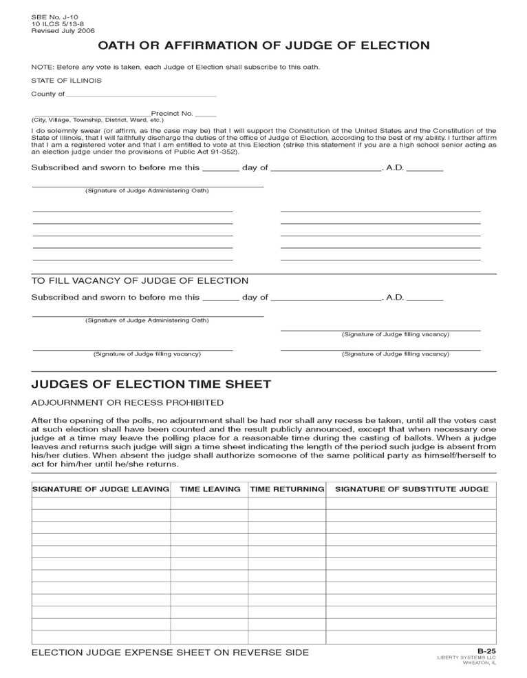
Take Your Oath of Judge of Election And Complete Your Expense Sheet
“I do solemnly swear (or affirm, as the case may be), that I will support the Constitution of the United States and the Constitution of the State of Illinois, and that I will faithfully discharge the duties of the office of judge of election, according to the best of my ability, and (in the case of a registered voter, that I am entitled to vote at this election).”
Sign the form and place it back in your materials.

Slide 17
Setting Up The Polling Place
Most polling places will be set up for you in advance.​
Configure your voting area with attention to:​
- Efficient flow of voters​
- Voter privacy while voting​
- Tabulator remains in full view of all election judges throughout the day ​
Review the supply checklist to ensure you have all the materials you will need.​
Call the Election Authority's office if anything is missing.

Slide 18
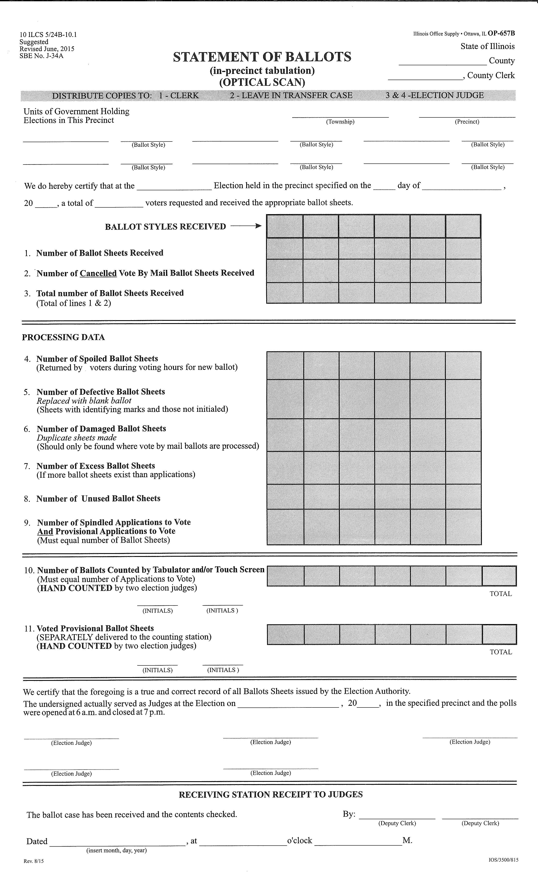
Statement of Ballots
Complete the statement of ballots
This begins the chain of custody for election materials throughout election day
Election judges are confirming the receipt of ballots issued to their precinct
The number of ballots received should match the number accounted for at the end of the night on the statement of ballots
(Not including VBM ballots surrendered during the day)
Make sure to keep track of your ballot counts throughout the day.

Slide 19
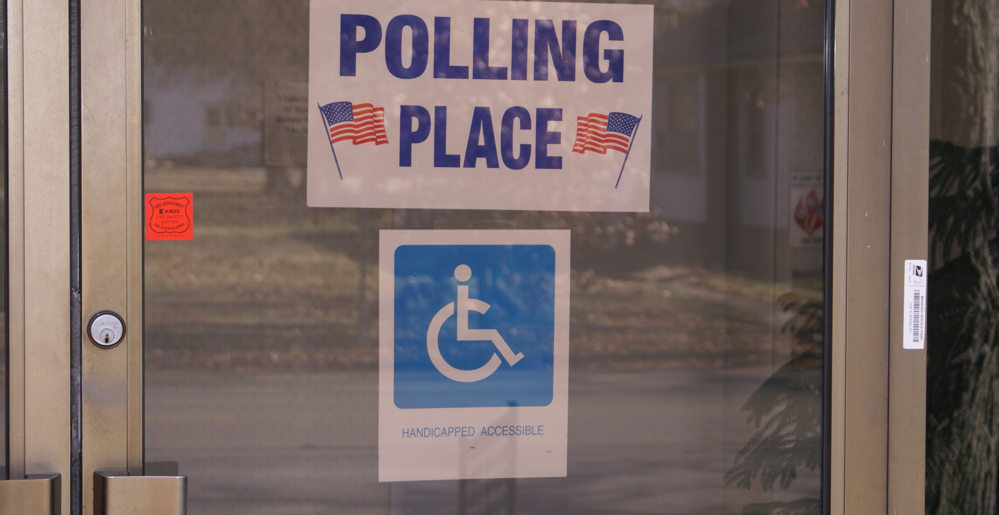
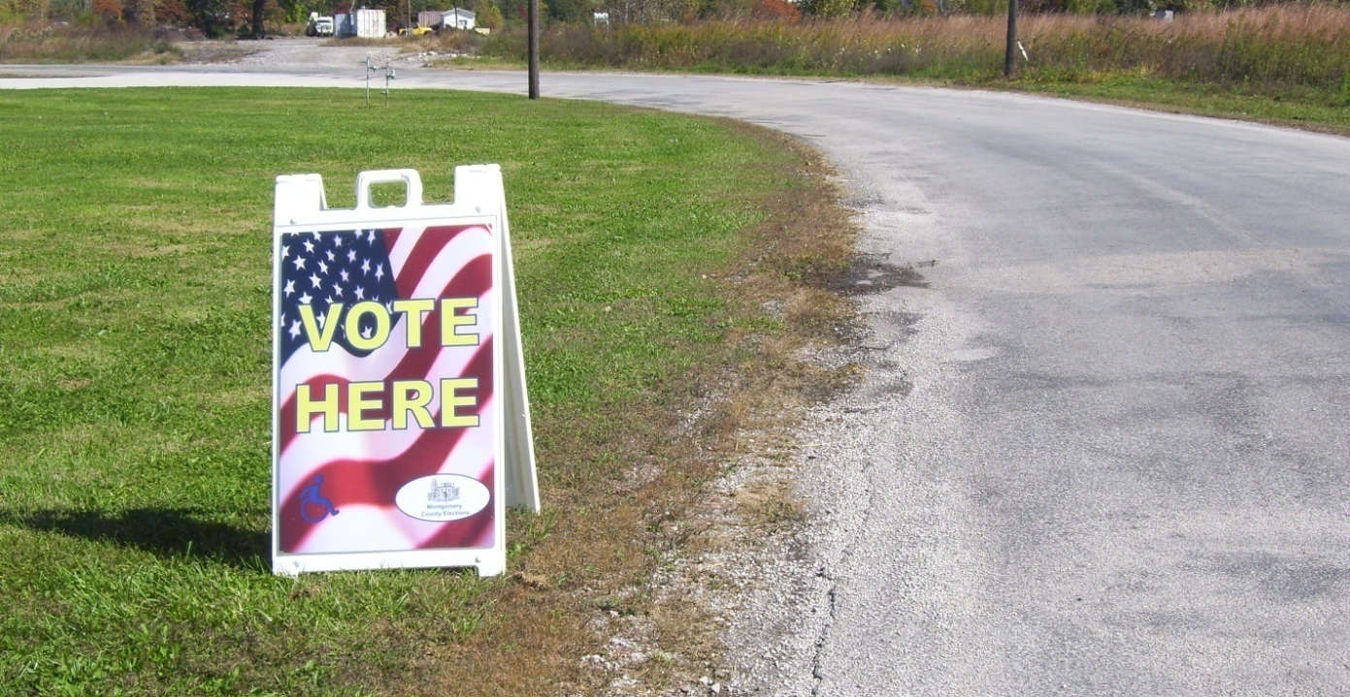
SIGNS!
Polling Place Entrance Sign & ADA Compliant Sign
- Should clearly identify the entrance
- ADA sign may not be on the main entrance used by most voters.
Public Roadway Polling Place Sign
- Should be placed on the public roadway nearest the entrance of the polling place.
- Must clearly identify polling place.

Slide 20
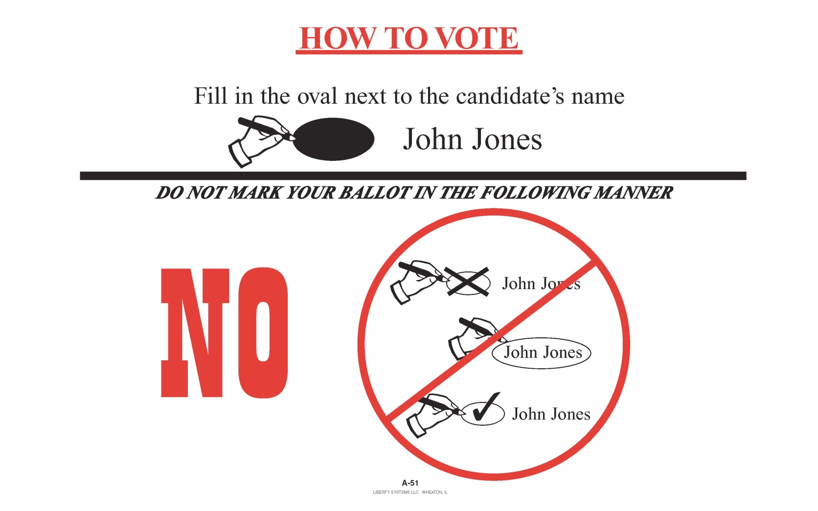
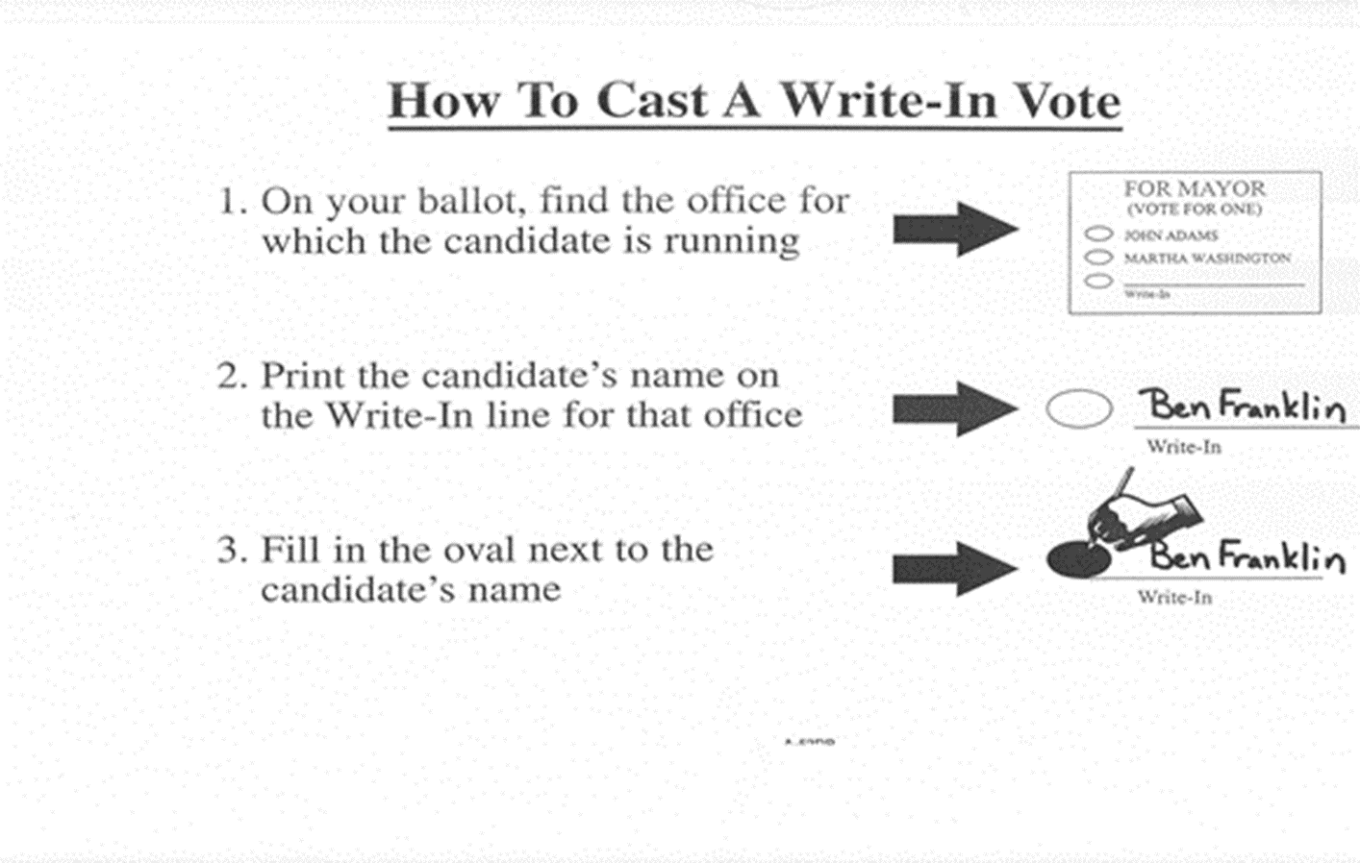
Post Instructions in Voting Booths and Around Polling Place!

Slide 21
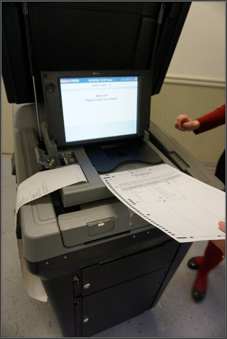
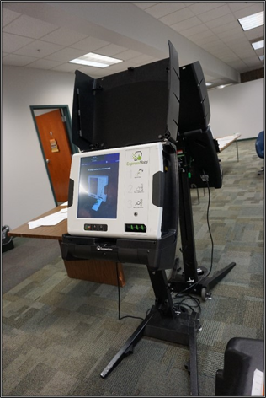
Two Forms of Equipment
DS200
ExpressVote

Slide 22
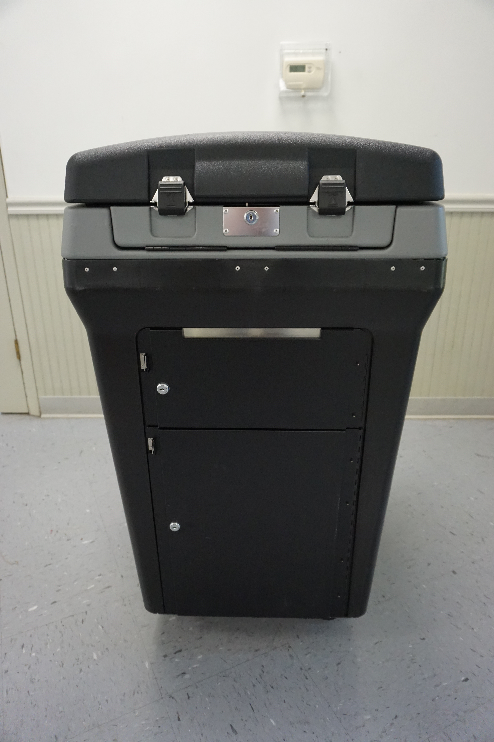
DS200 Preparation: Step-by-Step Instructions Will Be Provided

Slide 23
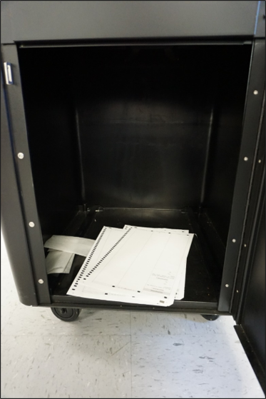
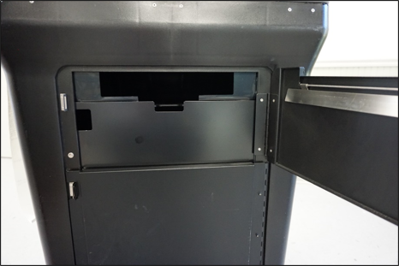
Verify that all compartments of the ballot box are empty.
Allow everyone present to inspect the empty ballot box.
Lock the ballot box and auxiliary bin.

Slide 24
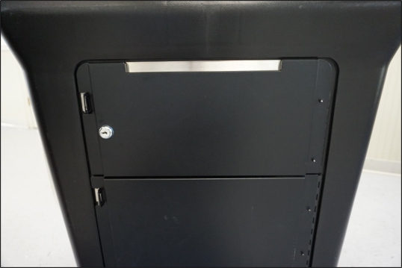

Close and lock all compartments
All compartments should remain locked until
AFTER
7:00 PM

Slide 25
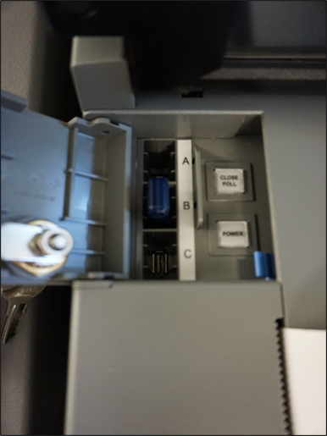
Memory Stick
Next, you will verify that the memory stick is inside the locked compartment. IF it is not, check your materials provided by the Election Authority. You may be required to plug it into the DS200.

Slide 26
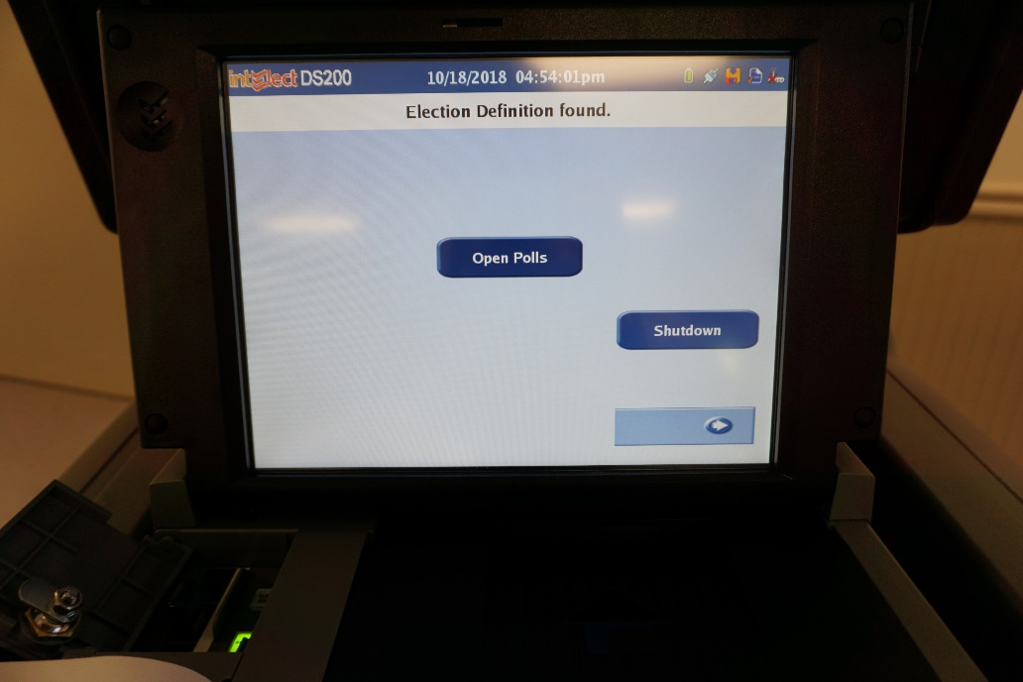
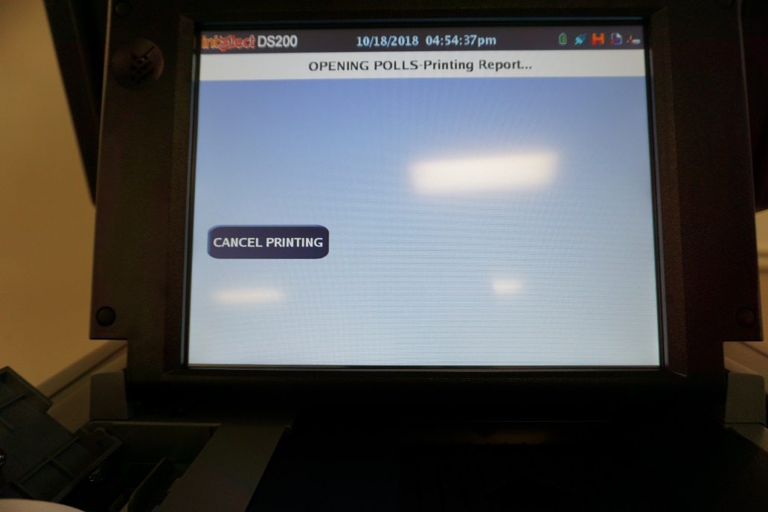
Type in election code Press “Open Polls” Print zero report

Slide 27
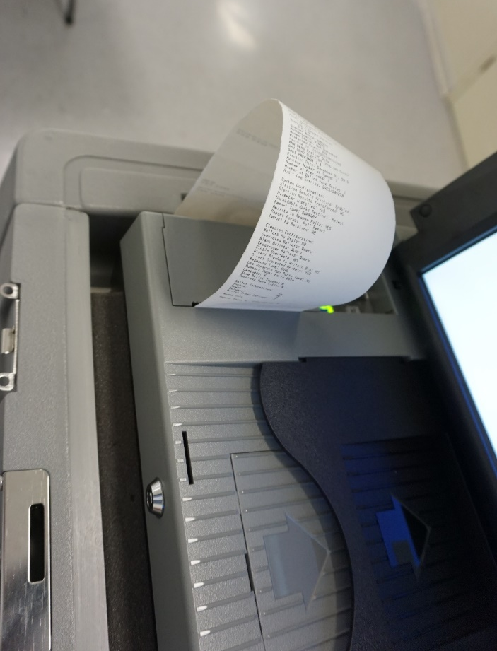
Zero Tape
Check date and time on tape.
Verify that the zero tape has no votes cast.
Check for correct precinct name and number.
Compare the tape to the specimen ballot.
Each judge must sign the zero tape.

Slide 28
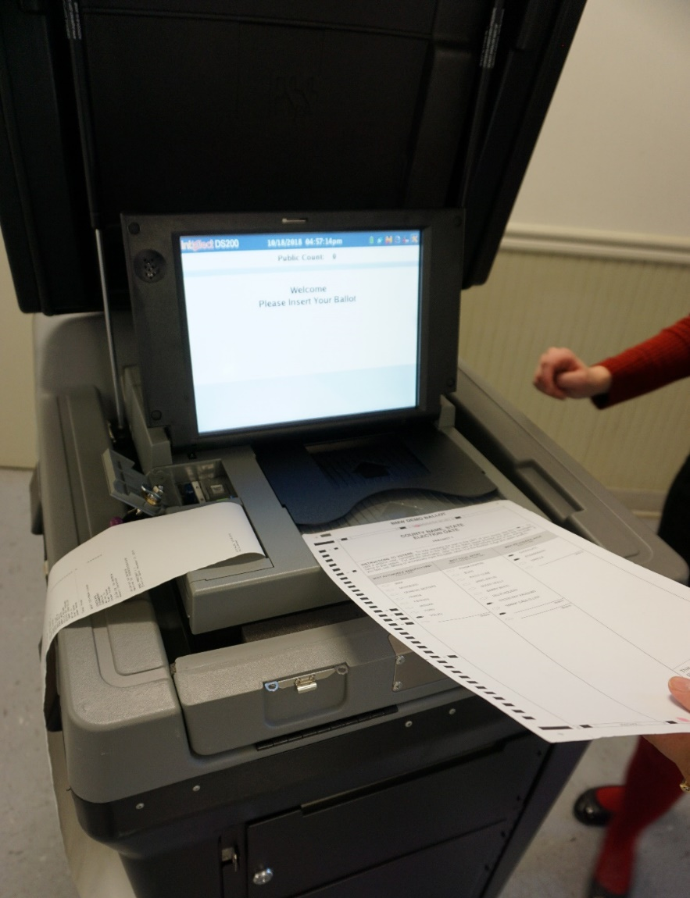
The DS200 is Ready!!

Slide 29
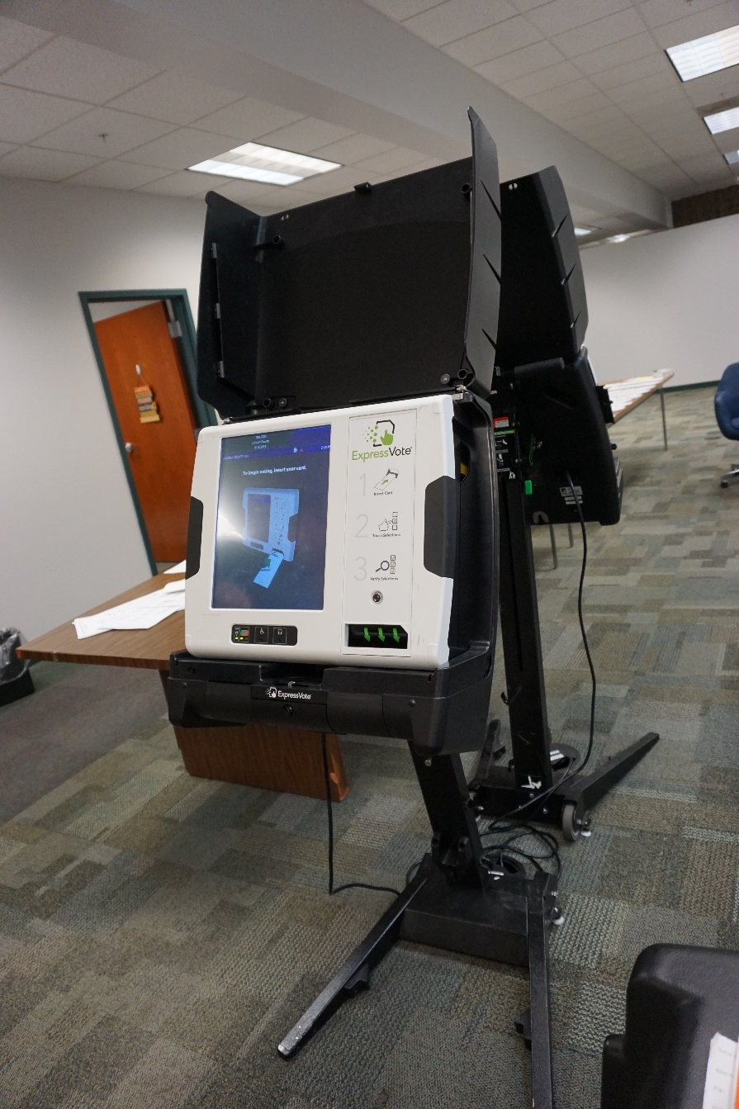
Express Vote Preparation
Step-by-Step Instructions Will Be Provided

Slide 30
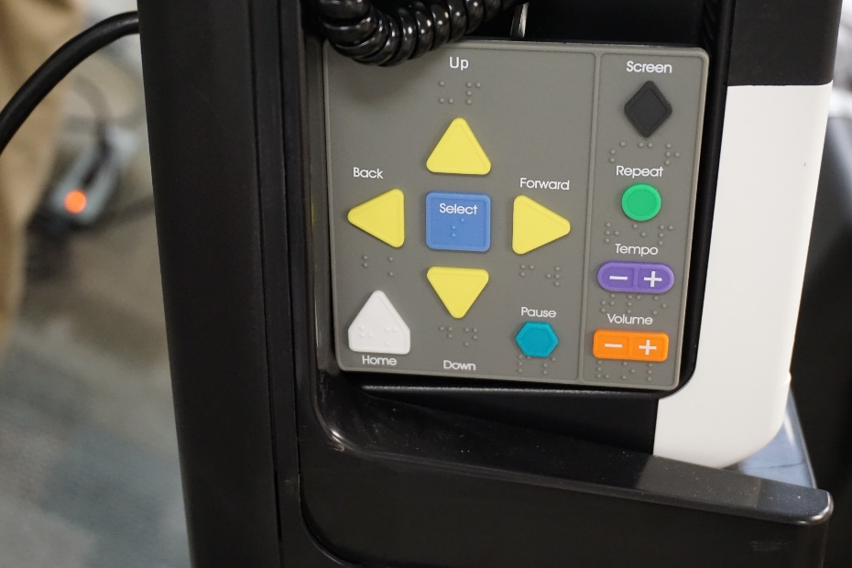
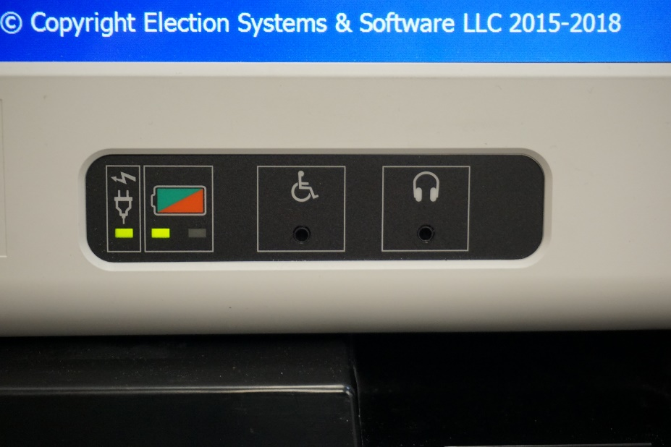
Accessibility Features
Keypad with Braille
Headphones

Slide 31
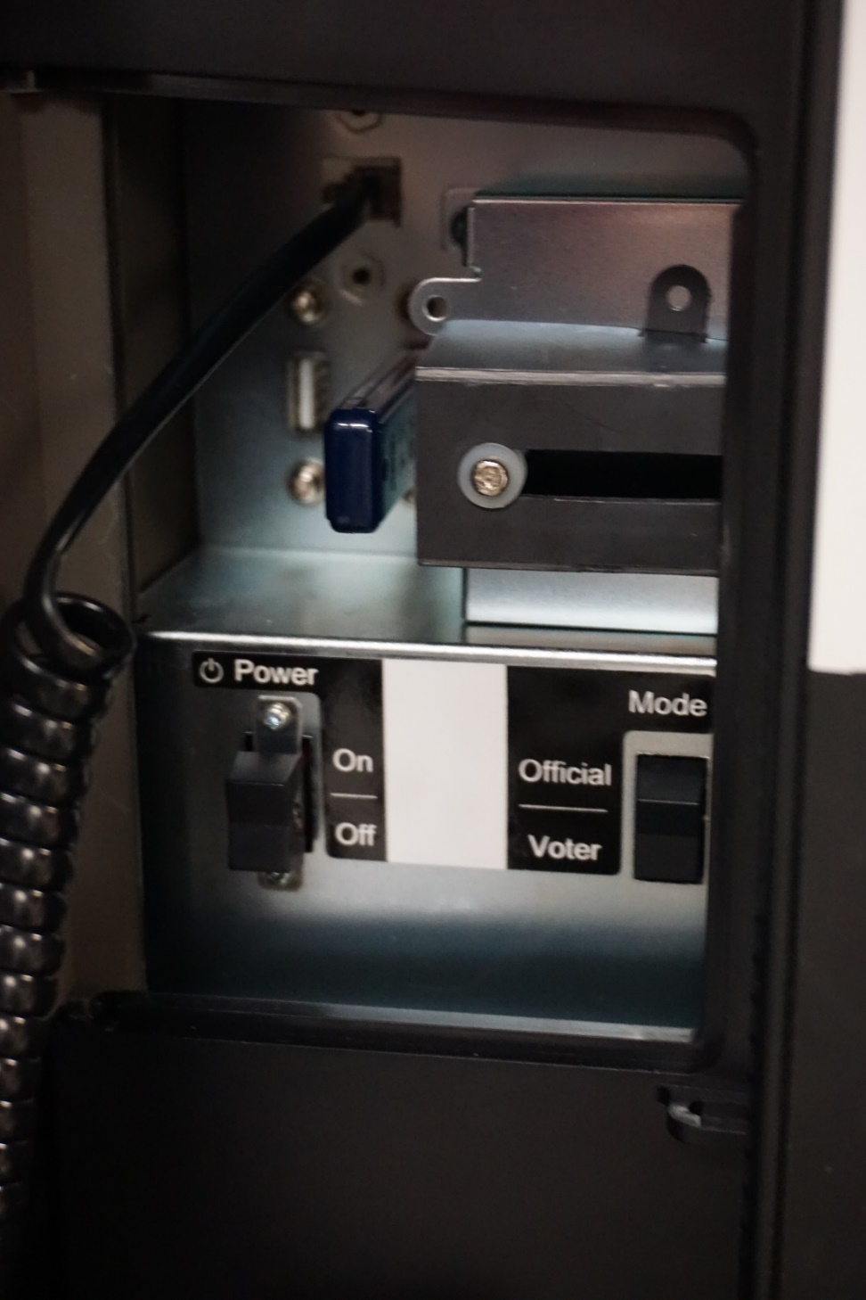
Unlock power compartment
Turn machine on
Verify memory stick is in the machine
Make sure the machine is in “voter” mode
Lock compartment up securely

Slide 32
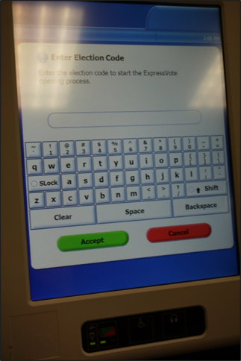
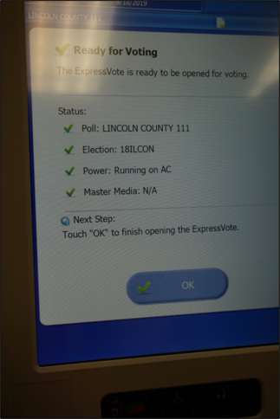
Press “ok” after the machine is finished setting up
Enter Election Code

Slide 33
The ExpressVote is Ready!!

Slide 34
During Voting Hours

Slide 35

At 6:00 A.M…
Announce out loud “polls are open!”
Unlock the door
Replace missing judges if approved by the election authority
Collect any pollwatcher credentials

Slide 36
A list will be provided for Early, Vote by Mail, and Grace Period voters.
If a voter is marked as already voted and claims they have not, CALL the Election Authority’s office!
If a voter was issued a Vote by Mail ballot, has not voted it, and surrenders the ballot to you on election day, they may vote as normal.
If a voter claims they never received their Vote by Mail ballot, they may sign an affidavit and vote on election day.
A voter cannot revoke or cancel a ballot that has already been voted!

Slide 37
Voters may be challenged by Pollwatchers, Election Judges, or another voter.
Reasons for the challenge:
Voter has moved
Voter has already voted
Voter has changed name
No record of registration
Not the same person as registered voter
Signature doesn’t match
Election judges, pollwatchers, and other voters who are in the polling place may challenge the qualifications of a voter
Challenging a voter is simply questioning their eligibility to cast a ballot and can often be rectified in the polling place.

Slide 38
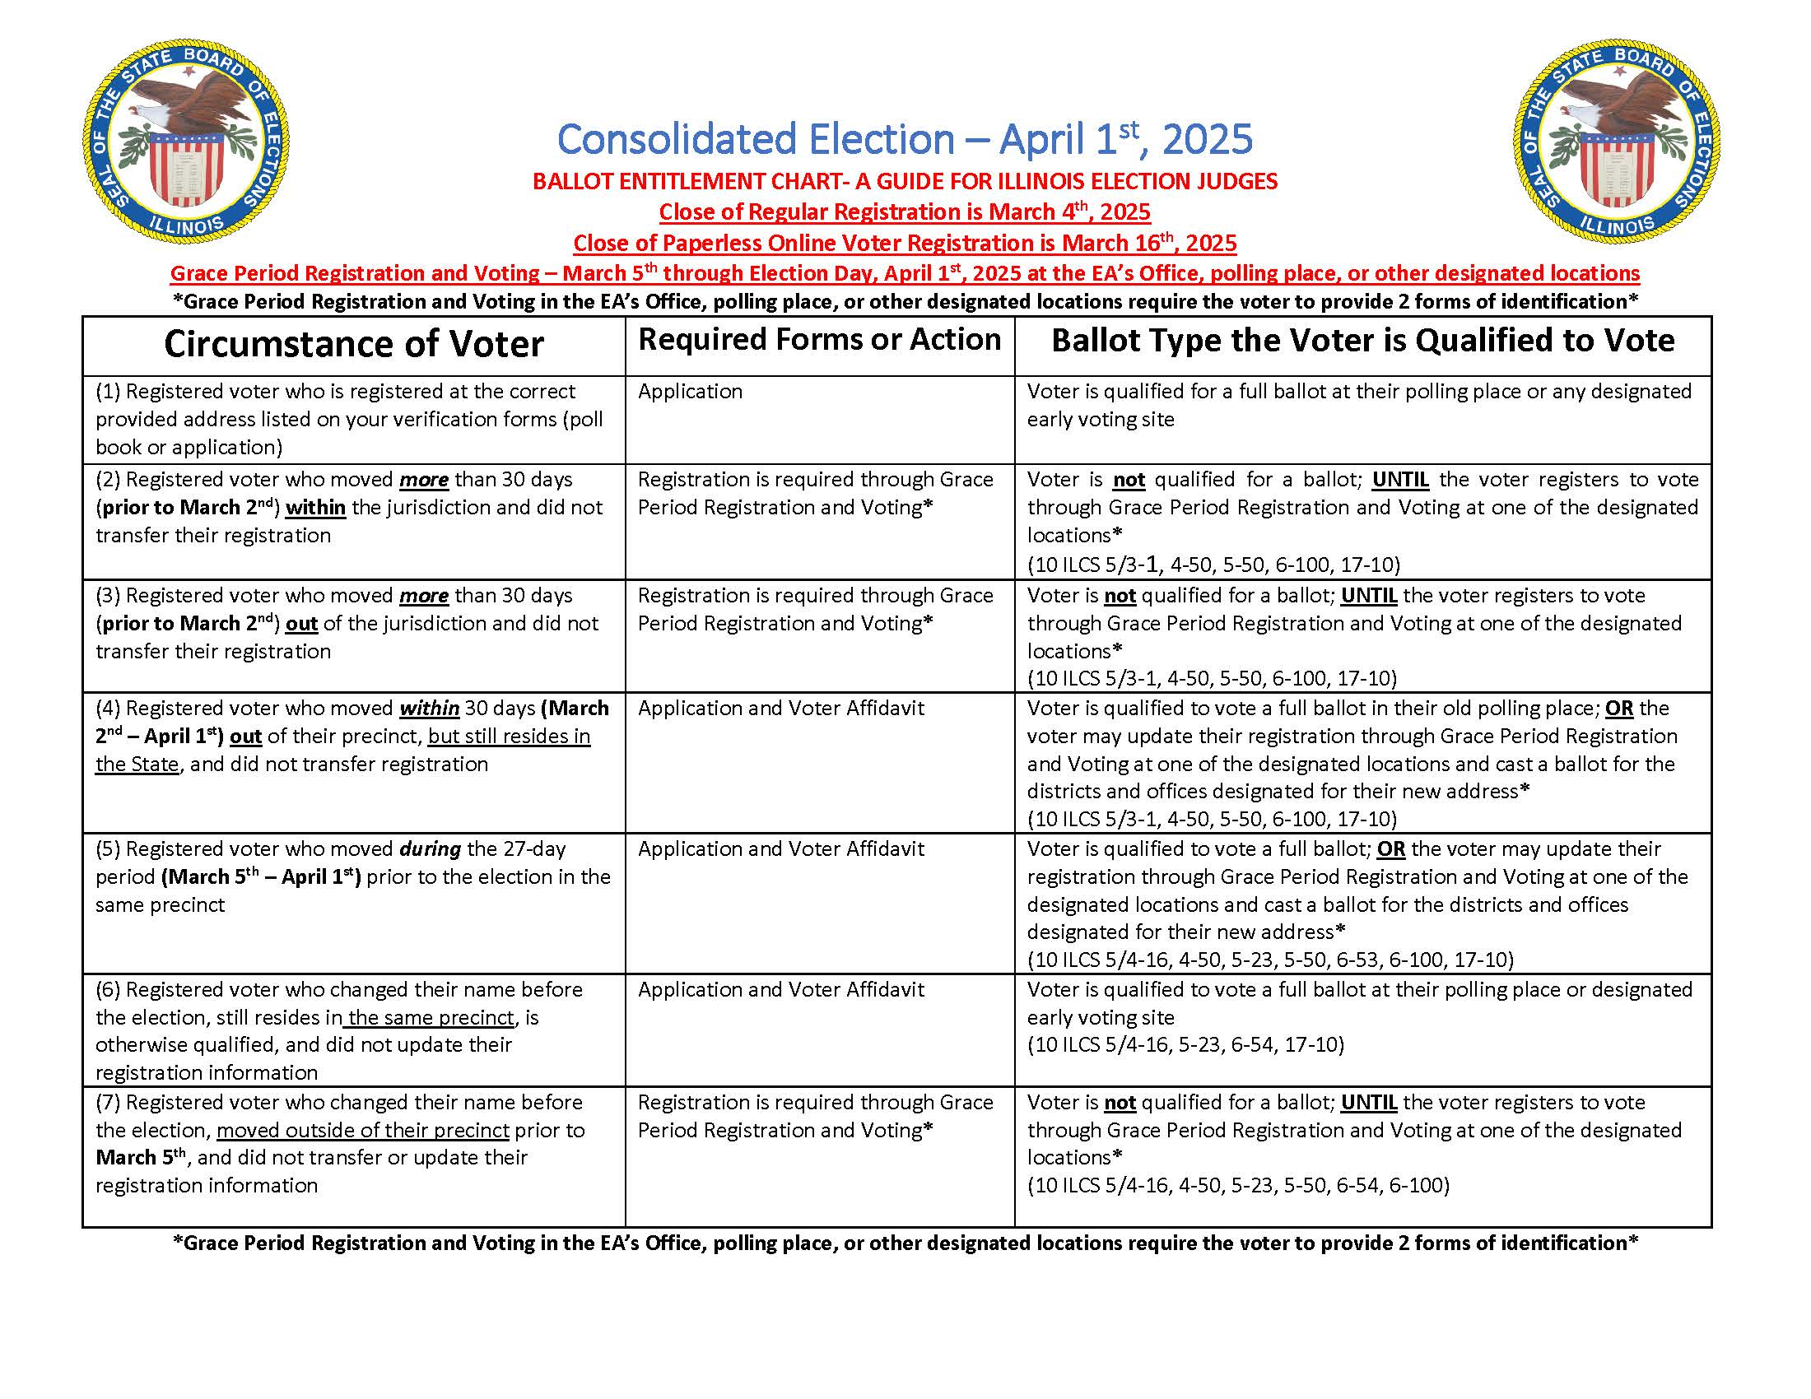
Ballot Entitlement Chart
Your quick reference tool for how to handle various circumstances of voters

Slide 39
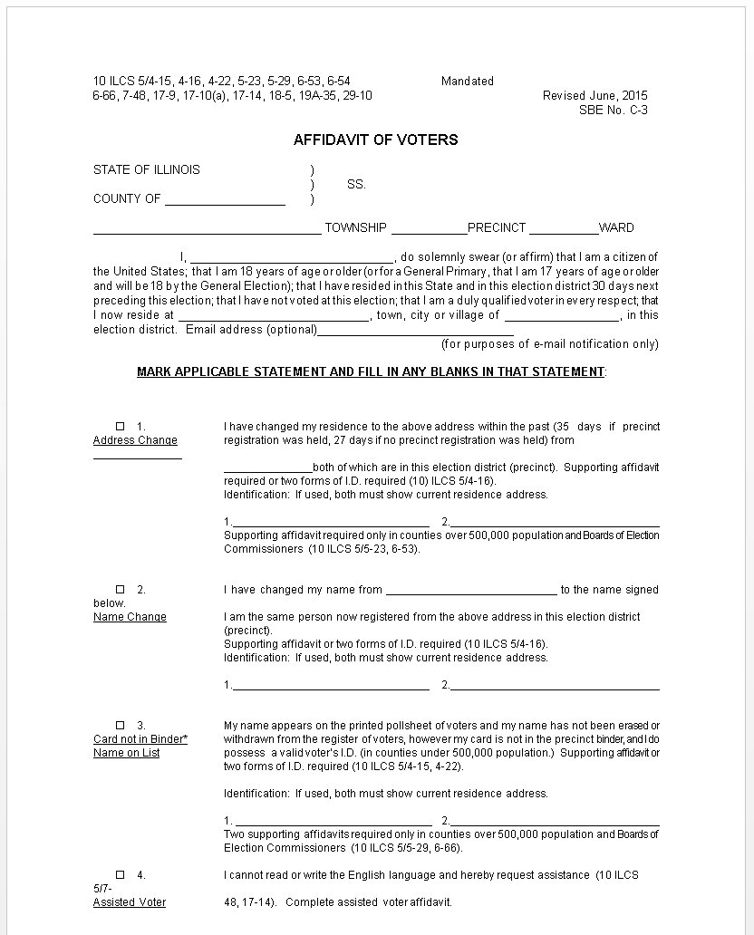
Voter Affidavit
Solutions to Remedy a Challenge Against a Voter
Change of Residence
Name Change (same precinct)
Name on list, no digitized signature to compare
Vote by Mail ballot not received
911 Address change

Slide 40
Solutions to Remedy a Challenge Against a Voter
Re-register
Voter can go to the Election Authority's office to complete a new registration
Most effective solution if they have moved outside the precinct or were never registered
Will need two forms of ID to register
Vote provisionally
Complete provisional voter affidavit
Voter will mark a regular ballot
Voter seals ballot inside a provisional ballot envelope
Ballot DOES NOT go in tabulator

Slide 41
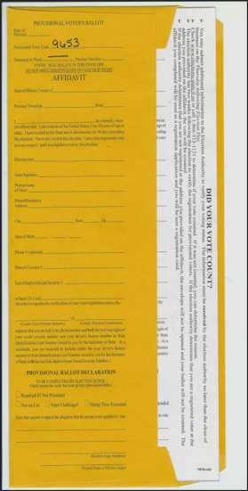
Provisional Voter Affidavit
Before you process a provisional voter affidavit....
CALL YOUR ELECTION AUTHORITY!!
When completing the affidavit both the voter and election judge will have sections to fill out.
The voter will be given a ballot and envelope; and directed to come back to the judges table after they have voted and sealed their ballot in the envelope.
The voter will be issued a receipt advising the voter to follow-up with the election authority within the next two weeks.
The judges will have a designated place to collect provisional ballots, follow your election authorities' instructions on returning provisional ballots.

Slide 42

When is ID Required to Vote?
Acceptable Forms of ID:
Driver’s License
State ID
Utility Bill
Student ID
Government Check
Paycheck
Lease or Contract for Residence
Bank Statement
Mail Addressed to Address of Residence
Other Government Document
Voters who registered to vote through the mail and did not include the required ID with their application.
- Application to Vote will be flagged with an indicator that the voter must provide ID to election judges before they can vote.
Voters whose eligibility to vote has been challenged.
- providing ID is one way to satisfy that challenge.
Voters who have moved
- Voter affidavit will remind you to ask for ID
Change of name
- Voter affidavit will remind you to ask for ID
Signature not on file
- Voter affidavit will remind you to ask for ID

Slide 43
Judge’s Station 1
Check-in or Greeter Judge
Voter should announce their name and address
Find the voter’s application to vote
Voter will sign application
Offer instruction to voter by using demonstrator ballot

Slide 44
Judge’s Station 2 Verification Judges
Judges will compare the voter’s signature with the one on file
If voter is eligible to vote, election judge will initial the application and pass it to the ballot distribution judge
Process affidavits if needed
Two Judges One Judge of Each Party

Slide 45
Judge’s Station 3 Ballot Distribution Judge
Ensure the voter is given the correct ballot/ballot style.
Ballots are designated by numerical code.
The number on the voter’s application will match the code on the proper ballot.
Offer instruction again.
Initial the ballot.
Direct voter to voting booth.

Slide 46
Judge’s Station 4 Ballot Box Judge
Check ballot for judge’s initials (should be visible even with privacy cover)
Voter inserts ballot into tabulator
Check voting booths throughout day
Over/ Under Voted Ballot:
Machine will notify voter
Voter can choose to OVERRIDE the warning and cast as-is, SPOIL the ballot and mark a new one, add votes if it is an UNDERVOTE

Slide 47
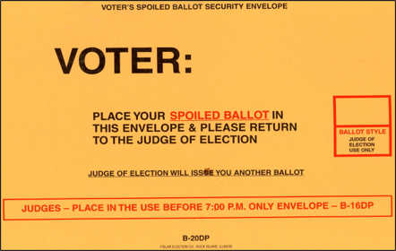
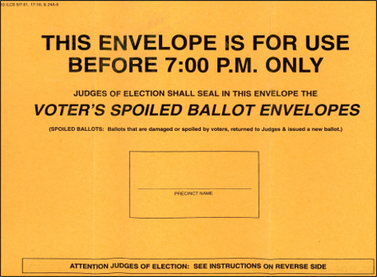
Spoiled Ballots
Voter should request a new ballot
Judge will mark the voter’s application
Voter will vote and tabulate the corrected ballot as normal

Slide 48
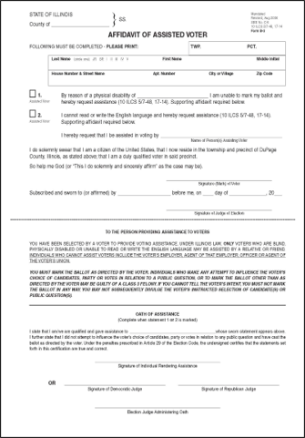
Voter Assistance Affidavit of Assisted Voter
For voters with disabilities or voters who cannot read or write the English language.
Must be completed every time a voter receives assistance in making their ballot.
Voter must attest that they are unable to mark their ballot without assistance and must name the person providing assistance.
Person providing assistance must attest that they will mark the ballot according to the voter’s wishes and will not attempt to influence the voter’s choice of candidates.
Affidavit of assistance gets spindled behind voter’s application to vote.

Slide 49
Who can and can’t give assistance?
Who CAN Give Assistance:
Friend
Relative
Two Election Judges
(one from each political party)
Who CAN’T Give Assistance
Voter’s Employer
Agent of The Voter’s Employer
Officer of The Voter’s Union
Agent of The Voter’s Union
REMEMBER:FILL OUT AFFIDAVIT!

Slide 50

Curbside Voting
Voter should notify the election authority the day before.
Two election judges ( one from each party)
Complete the process if voter was in polling place:
I. Voter completes application
II. Judges do the verification
III. Two judges deliver the ballot out with secrecy sleeve
IV. Voter will vote in secrecy
V. Two judges will bring the ballot back inside and insert into the tabulator
VI. Let the voter know their ballot has been counted

Slide 51
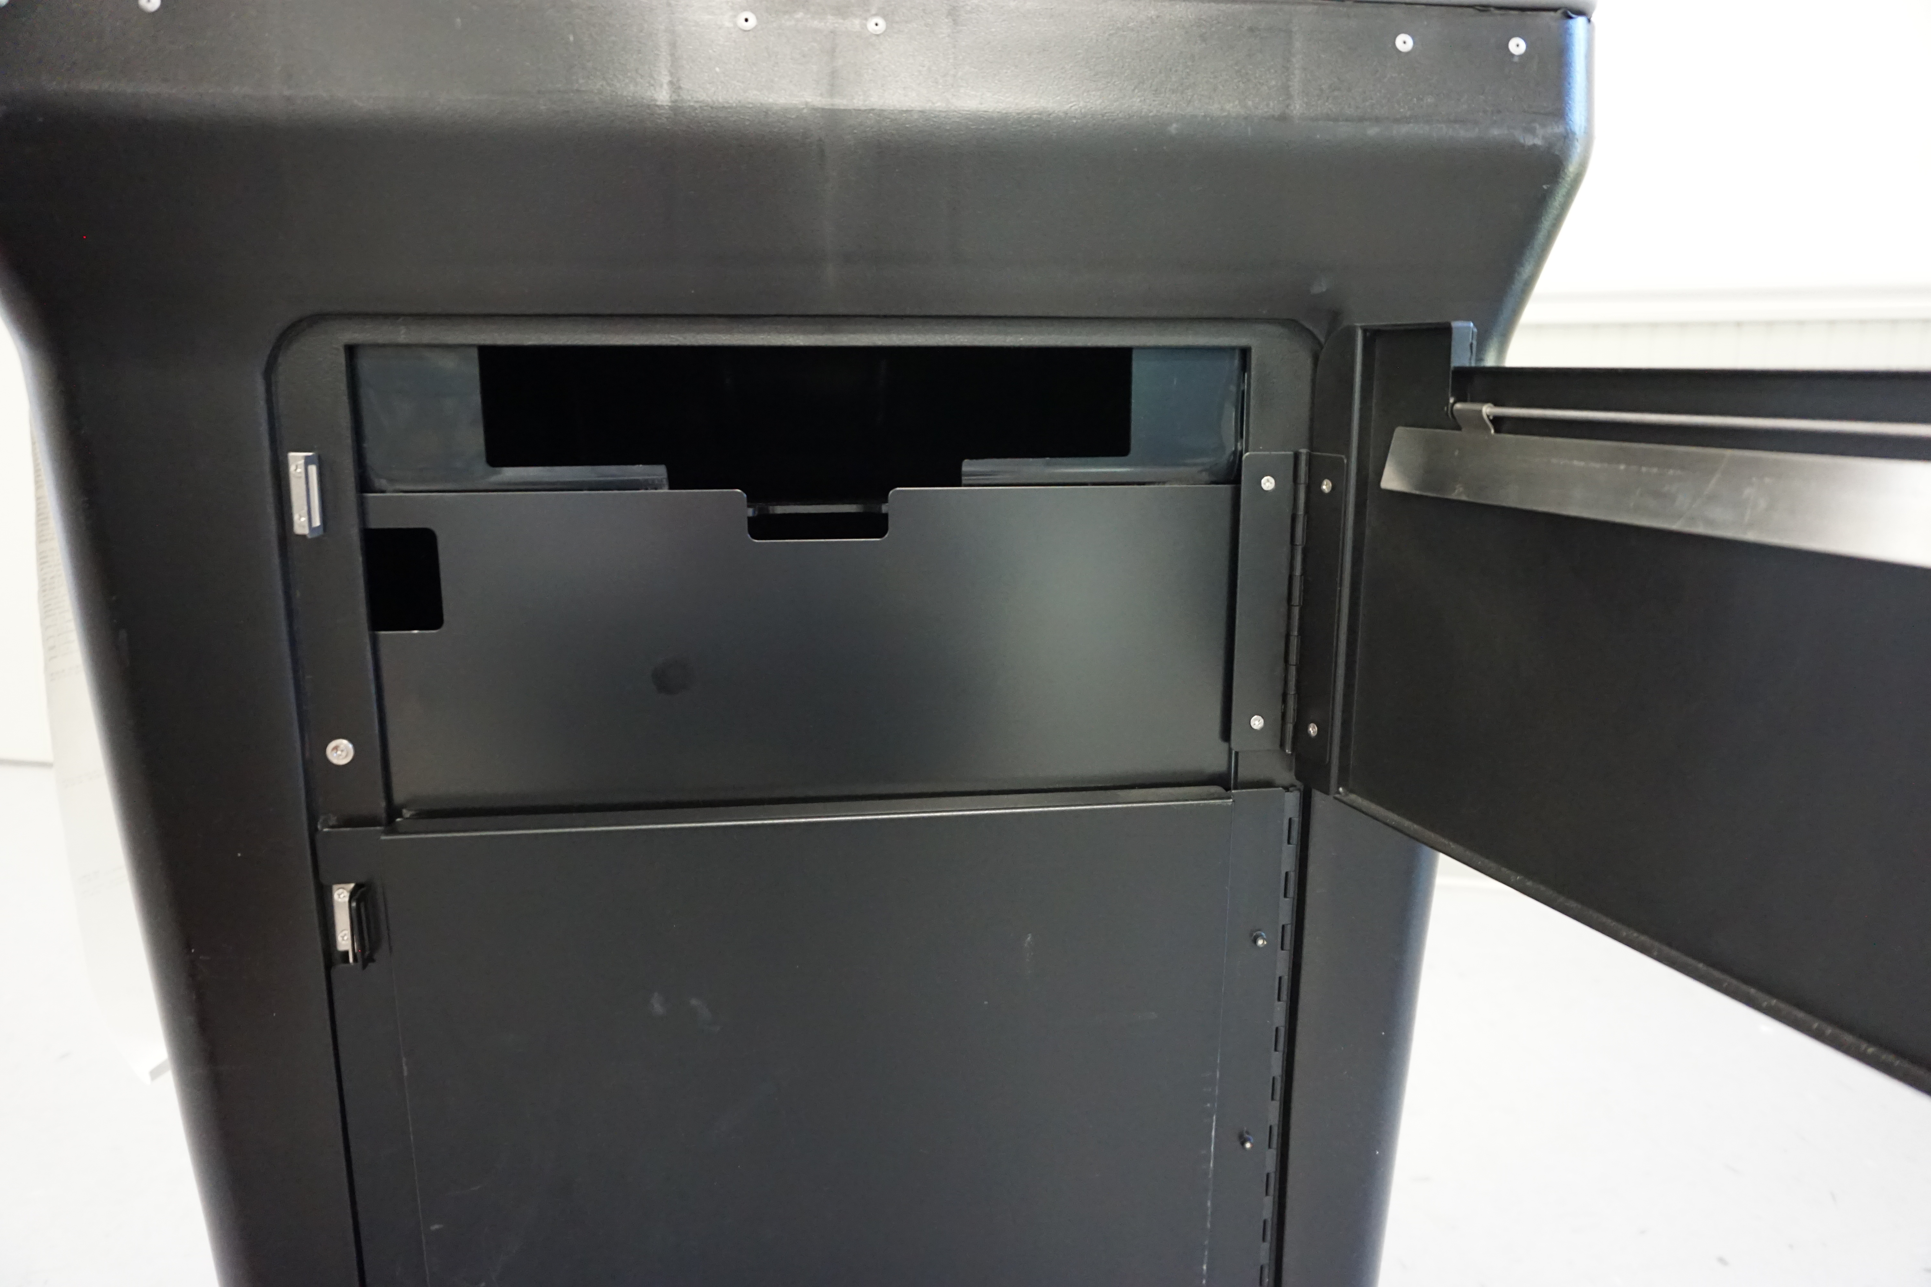
Tabulator Troubles….
What should you do when the tabulator breaks down or the power goes out?
CALL THE ELECTION AUTHORITY AND USE THE AUXILIARY BIN
Clip the security tag and log the number.
Voting should never stop.
Lock bin when tabulator is working again with the proper tag.
After the polls close, then remove ballots from the Auxiliary/Emergency Bin and process through tabulator.

Slide 52

At 6:30 PM…
Announce the polls will close in one-half hour.
Don’t forget to vote if you are in your voting precinct!

Slide 53

At 7:00 PM…
Announce out loud “Polls are Closed!”
All voters in line at 7:00 PM are allowed to vote
Close and lock door
Remove polling place sign

Slide 54
After the Polls Close

Slide 55
Who is Authorized to Remain in the Polls?
Election Judges
Pollwatchers
Law Enforcement Officials
Election Authority
State Board of Elections
Attorney General
State’s Attorney

Slide 56
Check the Auxiliary/ Emergency Bin
Before closing out the machine
Remove ballots from emergency bin
Insert ballots into tabulator

Slide 57
DS200 Shutdown: Step-by-Step Instructions Will Be Provided

Slide 58
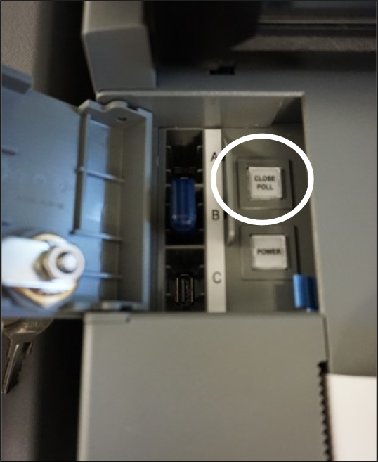
Press the “Close Polls” button in the locked compartment
Press “Close Polls” on the screen

Slide 59
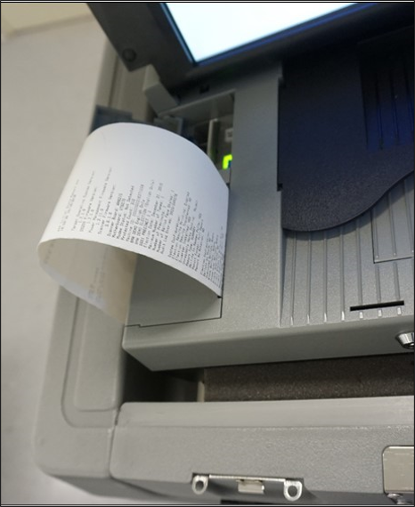
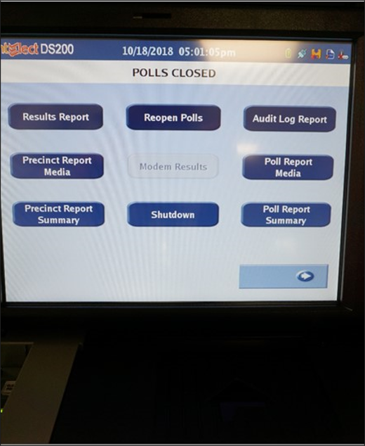
Press “results report”
Print as many copies as requested
Print copies for pollwatchers if requested
Judges must sign each tape

Slide 60
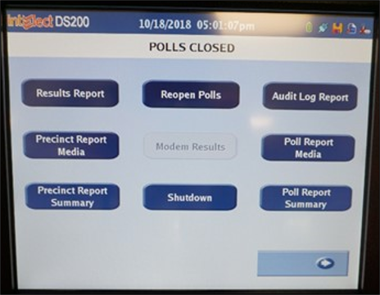
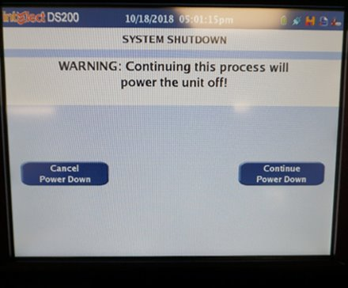
Press “Shutdown”
Press “Continue”

Slide 61
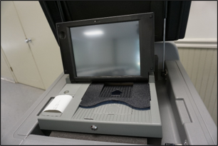
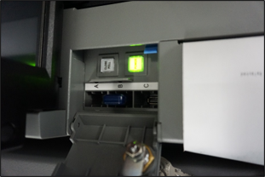
Follow your Election Authority’s Instructions!
Follow your Election Authority's equipment returning instructions.
Remove memory stick and return to counting center.

Slide 62
ExpressVote Shutdown

Slide 63
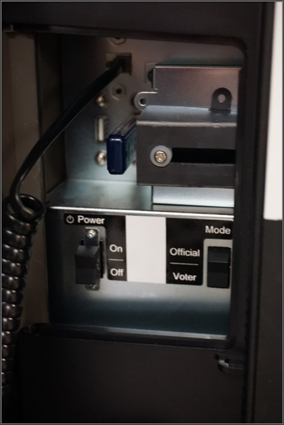
Unlock power compartment
Turn machine OFF

Slide 64
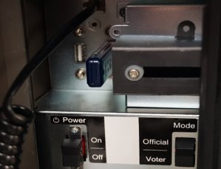
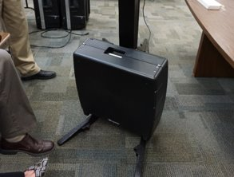
Follow your Election Authority’s instructions on what to bring back to the counting center!

Slide 65

Open the Ballot Box
Remove ballots from the tabulator
Ensure the number of ballots processed through tabulator equals the number of applications
Process write-in votes

Slide 66
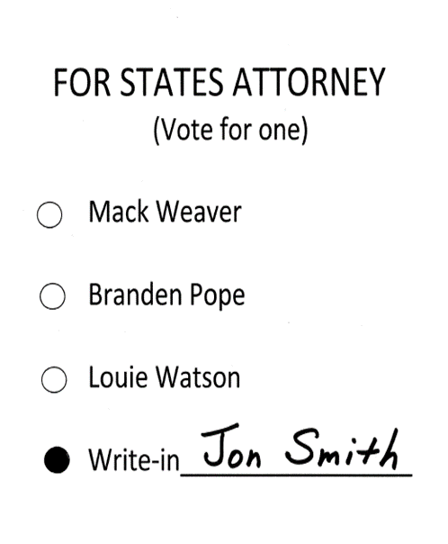
Processing Valid Write-In Votes
Write-In Must Be On Valid Write-In Sheet!
Determine the voter’s intent
Must be PRINTED or WRITTEN on the ballot line.
NO STICKERS OR STAMPS
Oval must be darkened

Slide 67
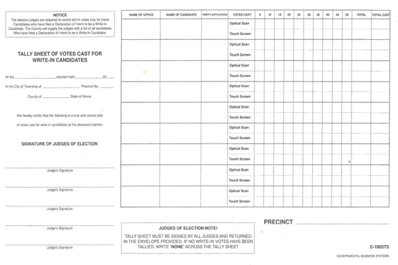
Tallying Valid Write-In Votes
NONE
If there is a valid write-in vote, tally it appropriately on this sheet.
If there are no write-in votes, write NONE across this sheet.

Slide 68
Review checklist provided by your Election Authority and return proper materials.
Tabulator Memory Stick/ Ballot Sheets/ Tape
Write-in Tally Sheets
Spindled Applications to Vote
Statement of Ballots
Signature Roster or Pollbooks
Voted Provisional Ballots
Completed Expense Sheets
Follow your Election Authority’s instructions on materials to return.

Slide 69

Complete and sign ALL forms Leave your polling place clean and tidy

Slide 70
Returning Materials
Two eligible judges, one from each political party, will deliver the materials DIRECTLY to the Election Authority’s office when everything is done so the Election Authority can close out the election.

Slide 71
The End

Slide 72
Test Answer Key
Test Answer Key
C
D
D
T
F
T
A
F
T
T
D
B
T
T
T
T
D
B
T
T
T
T
D
T
T
F
F
D
T
F

